Slide 1
Static Energy-Efficient Algorithms
The static energy-efficient techniques deals at circuit level, logic level and architectural level
when the circuit is switched on condition, there will be leakage, we can reduce the leakage current by using appropriate material for developing the PM(physical Machine).
The current leakage can be reduced using low voltage at output, size of circuit or by cooling the system which is in use.
The power consumption depends on the clock rate of CPU.

Slide 2
Static Energy-Efficient Algorithms
Exact Allocation Algorithm
The Pack is a set of VMs(virtual machine) for a set of nodes
If n is the requested VMs and m are the available servers at data center, they are denoted by Pj,max, where j = 1,2,...m.
The j is the VMs number which is given by the current energy consumption P_{j,current} . P_{j,current} = P_{j,idle} + ∑_{k} p_{k} with VMk host
Consider a decision value ej for every server where j will be 1 if j is selected by host VM otherwise it will be 0.
If the VM_{i} is placed in j server then it is expressed by x_{ij} = 1 else it will be assigned as 0.

Slide 3

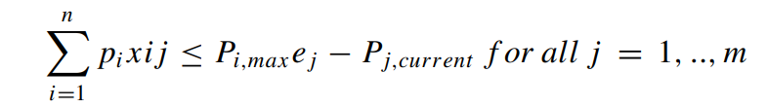
The requests are fulfilled by using a minimum number of servers and is given by
The number of servers depends on the capacity limits of VM that are assigned to one server or a set of servers based on the available resources.
The power limit of the server is given by P_{j,max} will not exceed when serving Vms are on the remaining capacity.

Slide 4

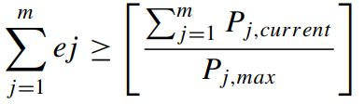
The inequality is given by verifying the condition P_{j,max} > P_{j,current} and P_{j,current} ≠0 and the lower bound of the total servers is calculated as
The inequality is given by
The exact and extended bin can be e _{j} = 1 else 0 if the server is not used and x_{i j} = 1 if V Mi is placed in server j otherwise 0

Slide 5
Best Fit Heuristic Algorithm
This is used to save energy and it is of two steps.
It sorts the requested VMs from higher to lower order of energy consumption to build the ordered stack.
The next step involves, the VMs are always handled from the top of the stack.
The most energy consuming servers are packed with least energy until the remaining servers of VM down the stack fits the target server.
This process is repeated until all the VMs are packed with the most occupied servers.
This will allow the servers to enter into sleep mode or switch off when they are in free or idle state

Slide 6
Dynamic Energy-Efficient Algorithms
The current utilization by the physical machine is treated as dynamic energy consumption.
It depends on the I/O activity, clock rates and the CPU usage scenario.
Dynamic energy can be consumed in two ways.
Switched capacitance which performs charging and discharging of a capacitor.
Short circuit current is a minor source of dynamic energy consumption.

Slide 7
The dynamic energy consumption can be reduced by reducing the switching activity and reduce the physical capacitance, reduce supply voltage, reduce the clock frequency.
The dynamic energy efficient techniques are further classified into Hardware based, energy-efficient algorithms and software-based, energy-efficient algorithms.

Slide 8
HARDWARE LEVEL SOLUTION
The hardware energy efficient technique works in fulfilling the requested services using minimum number of components.
This will further switch off the idle components of the system, varying the frequencies from minimum to maximum.
Dynamic Voltage Frequency Scaling (DVFS)
Dynamic Voltage Frequency Scaling (DVFS) strategy is used for reducing the power consumption by modifying the CPU frequency according to workload.
Voltage scaling is to reduce the energy consumption by adjusting the voltage to a threshold value without degrading the output.
It scales the voltage and frequency of the CPU during the execution process.

Slide 9
It is mainly used to enhance the energy-efficient scheduling on the servers that are in idle state, under light workloads during the execution of noncritical tasks.
This can be activated in four modes like High-frequency mode, Low-frequency mode, available frequency mode and on-demand frequency mode
The consumption of the power with this method is not that much reduced compared with the available other methods.

Slide 10
As it works at server level, switching off servers when not in use will reduce the energy consumption.
Many servers in the centers will be in idle mode at many times, can be made to sleep mode or power down at particular periods of time and made power up when in use.
The key method is to reduce the load and distribute the load to small number of VM servers which aims to reduce high consumption of energy.
Using VM live migration the reduction of energy consumption can be achieved

Slide 11
SOFTWARE LEVEL SOLUTION
The DVFS-based hardware-level solution will reduce the power consumption of PM by switching-off the PM present at idle condition.
Dynamic power consumption at software level of cloud data center can be reduced by using some energy-efficient AM allocation and migration algorithms, Task scheduling algorithms, network aware VM allocation algorithm, etc.

Slide 12
First Fit Decreasing Algorithm (FFD)
In this algorithm, first the bins are arranged in decreasing order, select the largest bin and examine to fit the VM in the package considering the size and packing cost.
The result has shown that the implementation of FFD proved to save 25% of energy
The algorithm steps are as follows:
List out all the Individual Tasks with its respective deadlines
2. Set a value by considering the maximum utilization rate for all the requested task (new)
3. Arrange all task from the higher order to the lower one based on the Deadline and Resource requirement

Slide 13
First Fit Decreasing Algorithm (FFD)
5. Calculate end time of the respective task
6. Arrange all the nodes of the cloud in decreasing order based on their utilization rate.
7. Arrange all the VMs in decreasing order based on the resource usage.
8. Set value for finding to reuse the VM is false
9. Check whether the physical elements (Each physical element (PE) to run a set of VM) are lesser than the threshold for the PE.
10. If a VM is allocated, change the value for finding to reuse the VM is true, list a task in VM

Slide 14
First Fit Decreasing Algorithm (FFD)
11. If the rate of utilization is greater than the maximum utilization rate then assign utilization rate value to the maximum utilization rate
12. If VM which is not able to reuse is false then initialize a new VM and allocate a task, repeat the above step
14. For every virtual machine in every physical element, If VM CPU is lesser than the minimum threshold, then identify the VM with less load where the load can be migrated to the other VM and shut down the previous VM
15. If PE CPU is greater than the maximum threshold then identify lesser loaded PE using greedy algorithm.

Slide 15
Modified Best Fit Decreasing Algorithm (MBFD)
In this Algorithm of Modified Best Fit Decreasing (MBFD), the VMs are sorted from higher to lower order based on the current utilization of CPU.
It is given by x*y where x are the number of VMs and y are the number of hosts.

Slide 16
The steps are as follows:
1. Make a list of all the hosts and VMs on the cloud server with all the available resources.
2. Arrange all the n VMs from higher order to lower order based on their utilizations
3. Consider each VM in list and check out the VM which requires minimum power to maximum power and list the m Hosts which are NULL.
4. If VM meets the host requirements, then estimate power consumption by both host and VM Else go to the step 4
5. If power requirement is lesser than the lowest power, then host is allocated to a VM with minimum power Else go to the step 4
6. If Hosts list has a NULL host then map a VM to the Host i.e n to m Else go to the step 3

Slide 17
Genetic Algorithm (GA)
Genetic Algorithm (GA) is an adaptive heuristic search algorithm based on natural selection and genetics.
This algorithm is used as optimization technique for the conservation of energy
Each individual in the population is coded with a finite vector variables.
Each individual is called as chromosomes and its variables are the genes.
Each Chromosome consists of several variable functions.
A fitness value is assigned to chromosomes.
Sorting operation is performed to find the optimal solution or near by optimal solution. Once the initial population is generated, the algorithm performs the following operations.

Slide 18
Selection Operator:It is used to select the best individuals from the set of population available and used to generate parent.
Generate fitness value, sort them according to their decreasing value. Based on the fitness value, preference to the individuals are given allowing them to pass the genes to the next level.
Calculate the average fitness value, divide the group into two parts based on the average value where one part p1 consists of individuals whose fitness value if greater than the average and the other part p2 consists of less than the average value.
Select each from one part using the selection operator, where p1 member ensures better value and p2 member has less fitness which is used to maintain the population diversity.

Slide 19
Crossover Operator: It is used for choosing the matching chromosomes and combining them to generate next level of population. The chromosomes are chosen from the two parts of population using the selection operator.
Mutation: Performs random changes. Some of the bits with low probability, which are flipped. This is used to maintain diversity in the population.

Slide 20
Particle Swarm Optimization (PSO)
Particle Swarm Optimization (PSO) is used to find the fitness of each individual particle leads to a feasible solution to the problem present in the cloud.
Each particle consists of velocity and position
The algorithm starts with the initialization of a group of particles randomly, finding the optimal solution by performing iterations.
Every particle in the group changes its position with a specified velocity by searching the local best position Xl_{best,i} and the global best position Xg_{best,i}.

Slide 21
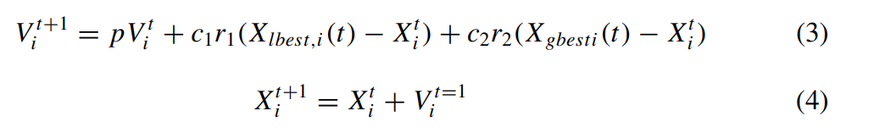
The velocity of each particle along with the positions are updated by the following equations.
V^{t} _{i} and V^{t+1} _{I} are the velocity before updated and after updated respectively, X^{t} _{i} , X^{t+1} _{I} are the before and after updated position respectively.

Slide 22
The p is the inertia weight coefficient which defines the current inheritance velocity of the particle, balanced by local and global search capabilities.
The learning factors are given by c1 and c2, and the random numbers lies between 0 and 1 are presented by r1 and r2.
Particle Position:
It is defined by n bit vector where n is the particle code which is equal to the number of servers in the data center. The position is given by X^{t} _{i} = (x^{t} _{i1}, x^{t} _{i2}....x^{t} _{in}).

Slide 23
Particle Velocity
It is defined by V^{t} _{i} = (v^{t} _{i1}, v^{t} _{i2}....v^{t} _{in}) where n is the bit vector that presents the adjustment decision of the VM. V^{t} _{I} guides the particle position which is 0 or 1. If the re-evaluation and the adjustment is required then 0 otherwise 1
Subtraction Operator
It calculates the distance between two VMs and represented by Θ. It is called as binary subtraction operator in PSO.
If the operands contain same bit value then the position of the vector value is 1 else 0.

Slide 24
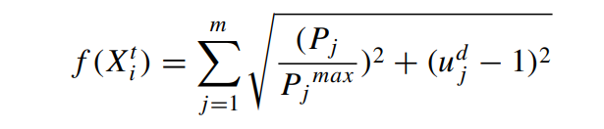
Addition Operation
In PSO we have to consider local optima solution as well as Global optima solution of the fitness value.
In order to find the best fitness value, we require global optima solution and local optima solution.
For this, we consider three inertias along with uncertainty bit q.
The final fitness value along with the inertia is as follows:

Slide 25
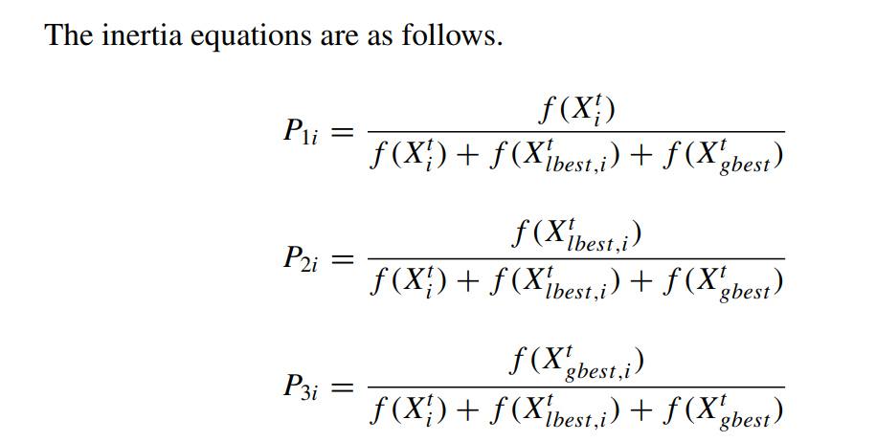

Slide 26
where f(X^{t} _{i}) fitness value of ith particle of the solution. X^{t} _{i} , X^{t} _{lbest,i} and X^{t} _{gbest,I} are the local, global best position of the ith particle.
In order to calculate the inertia, Consider the high-energy efficiency and maximum utilization with high probability.
we consider three uncertain bits as there are three inertias.
These bits are given by
uncertainbit = q1 if rand ≤ P1i ,
uncertainbit = q2 if P1i < rand ≤ P2i and
Uncertainbit= q3 if P2i < rand ≤ P3i .
q1 is the bit value of particle before updating, q2 is the bit value of local best particle and q3 is the bit value of global particle.

Slide 27



Multiplication Vector
It is represented as and used to update the position. If the current position s given by X_{P}i^{t} and the vector velocity as then the multiplication works as .
The rule of multiplication is, if the bit value of the velocity vector is 1 then the corresponding position vector is not disturbed else it will be adjusted to the required position.

Slide 28
Ant Colony Optimization (ACO)
The requests from the users contain the details of the resources required.
All the requests are kept in the queue and maintained by the controller.
Ant Colony Optimization algorithm helps to allocate and maintain the cloud services in systematic way.
Initially, listing out all the available valid nodes and a pointer pointing to it.
If a request from a customer receives:
If the requirements of a customer match with the available node, then it creates a basic Virtual Machine.

Slide 29
Ant Colony Optimization (ACO)
4. Create a Monitor ant to supervise the Virtual Machine for balancing the load. It always returns three values one for mentioning balancing is not required, other mentions it is recommended for balancing and the final value is strictly balancing is required. Go to step 7.
5. If the capacity of the pointed node does not meet the requirements of the customer then automatically pointer moves to next available valid node. Go to step 4.
6. If all the nodes in the list doesn't happen to meet the requirements then alert the admin mention the shortage.

Slide 30
Ant Colony Optimization (ACO)
7. Monitor ant will return Throughput and Response Time Throughput THRPUT, Response Time RT and Average Response Time AvgRT
8. If RT < 0.9 * AvgRT AND THRPUT > 1.1 * THRPUT then return 0
9. Else if 0.9 * AvgRT< RT < 0.95 * RT (OR) 1.10 * THRPUT > THRPUT > 1.05 * THRPUT
Then if both the conditions are true then the VM is suggested for balancing and VM is cloned
Otherwise if only first condition is satisfied then also VM is suggested for balancing the Load and VM is cloned
Else if only second condition is satisfied then VM is suggested for balancing the Load gets migrated

Slide 31
Ant Colony Optimization (ACO)
10. Else if RT > 0.95 * AvgRT (OR) THRPUT < 1.05 * THRPUT then
Then if both the conditions are true then the VM is severely need of balancing the Load and VM is cloned
Otherwise if only first condition is satisfied then also VM is severely need of balancing the Load and VM is cloned
Else if only second condition is satisfied then VM is severely need of balancing the Load gets migrated
11. Testing Ant: If processor utilization (or) memory consumption is greater than 90% then arrange the VMs from higher to lower order and select the top most VM
If VM Monitor returns value = 2 then go to step 11
If VM Monitor returns value = 1 then go to step 13

Slide 32
Ant Colony Optimization (ACO)
12. If processor utilization (or) memory consumption is less than 50% then consider all the other nodes capacity and arrange them from the higher capacity to the lower. If there is possibility to migrate all the VMs to a single node then migrate them.
13. If the monitor mentions that node is critically in need of Load Balancing and clone the VM and if any node is available with enough resources allot the respective node.
14. If there are VMs whose monitor returns that any node has more than 30% of resources available then active the power effective node. If the particular node is standby activating the selected node
15. If all the nodes are utilized in the list then alert the admin mention the shortage.

Slide 33
Simulated Annealing (SA)
The basic idea is taken from annealing process which has three stages.
Heating stage is used to enhance the thermal motion of particles to deviate from its position.
Isothermal Phase for the exchange of heat with surrounding within a closed room of constant temperature.
Cooling Stage is for making the thermal particle weaken where the energy decreases gradually and form it into a low energy crystal structure

Slide 34
Simulated Annealing (SA)
It is applied to reduce the workload of VMs by using task scheduling which is as follows.
Select the initial value x and fix a high temperature.
The task scheduling is given by E = f (x) where E is the energy and F(x) is the general function.
For initial task scheduling, it uses Greedy method which uses the task priority principle.
Select three VMs say as m,n,o and set them to PMs M,N,O.

Slide 35

Simulated Annealing (SA)
Resecure these as m to N physical machine (PM), n to K Physical Machine (PM), O to M Physical machine (PM).
calculate new values then accept the new path else accept it after some probability of time and cool down the system.
If path is accepted then stop else repeat the process of assigning VMs to PMs.
If E(y) is the function value at y and Y is the current state and Y* is the new state, r is to control the speed, T is temperature and T ∗ is the minimum temperature.

Slide 36
Simulated Annealing (SA)
If T is equal to T* then stop the process of cooling else follow the following steps.
While(T > T ∗)then E = E(Y ∗) − E(Y ) i f (E ≥ 0)Y ∗ = Y happens only when more optimal solutions are found else i f (exp(E/CT )) > random(0, 1)where C is a constant system.
Then Y ∗ = Y and T = r ∗ T . If 0<r<1 and if r is large lower the cooling
If r is too large then search for possibility of a global optimal solution will be high and the search time also be high, and r is low, search will be fast and the solution will be local optima.

Slide 37
Cat Swarm Optimisation(CSO)
The Cat Swarm Algorithm was emerged by observing the behavior of cats which consists of seeking and tracing mode
Cats are very alert even if they are in rest mode.
Seeking Mode:
This mode is used to find the position of the cats which require four parameters like Seeking Memory Pool (SMP) used to store the surrounding information and picks it from the pool when required.
Seeking Range Dimension (SRD) is used to declare the mutation ratio. If some new value is created based on the mutate dimension, it will be within the range of SRD.
Counts of Dimension Change (CDC) is used to disclose how many dimensions are changed.
Self Position Considering determined by the cat where it is already in position. It uses a boolean value

Slide 38

Cat Swarm Optimization
The seeking mode consists of five steps which are as follows:
1. Make a set of i copies of the current position of the cat where i = SMP, if SPC = 1 then i = (SMP-1).
2. According to CDC, add or subtract SRD of the current value and replace with old ones randomly.
3. Compute the fitness value of each and every point in SMP
4. select a probability of each point by where 0<j<I, else set all the points to 1.
5. Pick a point randomly from a set of points and replace the cat

Slide 39



Cat Swarm Optimization
The goal of the fitness value is to find out a minimum solution then
Tracing Mode:
This is based on the targets traced by the cat and the action of the cat consists of three steps.
1. update the velocities of the cats according to
where d=1,2,...N xbest is the cats best position based on its best fitness value, c is a constant and r1 is a random value that lies in between [0,1]
2. check whether they are in maximum velocity range. If the new velocities are of high range, set them to a limit.
3. update the positions of cats based on

Slide 40
Cat Swarm Optimization
The complete operation consists of six steps
Initialize the swarm of M cats in D dimensions
Randomly assign the values to find current position and velocity of the cats
Assign MR (mixed ratio) based on the percentage of cats for the population available in the tracing mode and the rest for seeking mode.
The fitness value of each cat is found and the best value is stored in the memory
update the position of the cats in the seeking mode and in the tracing mode.
if the value is true stop the process for the cats else continue the process till it finds a feasible solution.
By using the above steps, eliminate the unnecessary use of energy by the VMs. The Vms are shifted to the PMs and the servers which are not in use will be in sleep mode.

Slide 41
Hybrid Genetic Algorithm and Cat Swarm Optimization (HGACSO)
A finite number of chromosomes are used to generate the initial iteration.
Based on the fitness solution, the generated chromosomes are sort in decreasing order.
From the full set, the half of the chromosomes are discarded and the other half will be used for further process
The best-selected chromosomes will be treated to the initial cats of CSO.
The initial solution will divide the cats into two groups randomly, where one group is used for the seeking mode and the remaining other for tracing mode.
Find the best cats from the available cats and create a copy of these best cats from the obtained two groups.

Slide 42
Hybrid Genetic Algorithm and Cat Swarm Optimization (HGACSO)
Use this obtained copy for the crossover and mutation process.
Once the operation is applied, arrange the cats and chromosomes in decreasing order based on the fitness value.
Use the half of the cats from the group for new generation and discard the other half of the cats.
In enhancement encoding, if the chromosomes are in 2s number, it generates 2s-1 randomly.
Map the chromosomes randomly like (V Mi to PMi) = map_{i} and the remaining chromosome are generated using FFD technique.
This FFD technique sorts all the VMs from higher to lower order based on their capacity, allocate VM to PM using the First Fit Algorithm.
The size of the chromosomes must be equal to the number of physical machines present at the data center.

Slide 43
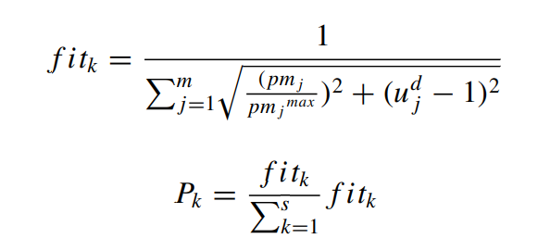
Hybrid Genetic Algorithm and Cat Swarm Optimization (HGACSO)
Fitness Function
Euclidean distance is applied to find the fitness of the chromosomes using the objective function f. The fitness value and probability of the chromosome selection is given by
The maximum fitk value of the chromosomes will be considered for next generations.

Slide 44

Hybrid Genetic Algorithm and Cat Swarm Optimization (HGACSO)
Cat Position and Encoding
The position of the cat is defined by a bit vector m where m is the number of physical machines (PM) present in the data centers. The position of the ith cat in a m-bit vector at iteration t is given by
and the bit value is given as 0 or 1 for each position vector.
Each chromosome is treated as cat and converted to binary representation like PMs to VMs by assigning 1 or 0.

Slide 45
Hybrid Genetic Algorithm and Cat Swarm Optimization (HGACSO)
Seeking Mode
Select the maximum ratio from n_{c} fraction in the seeking mode and the remaining are moved to the tracing mode.
Create a Seeking Memory Pool (SMP) for storing the copies of the selected cat.
The seeking range of selected Dimensions of the current position is arbitrarily revised by adding or subtracting the dimensions d of the position of each copy using the Count of Dimension (CDC).
Based on the dimensions, calculate the fitness of all the copies.
From the available copies of cats, the best cat is selected and sent to the selected seeking cat.
Continue the same process for all the other cats present in the seeking mode

Slide 46

Hybrid Genetic Algorithm and Cat Swarm Optimization (HGACSO)
Tracing Mode
This mode is responsible for the position change from one PM to another by applying the velocity.
The tracing mode consists of the following parameters.
Cat Velocity T
The obtained cat position is calculated based on the velocity of the current cat position.
It is represented by
where V is the velocity i is the ith cat and m is the velocity vector and t is the iteration.
The velocity vector m value will be 0 or 1.
In the first iteration, a randomly generated velocity is applied on the current position of the cat

Slide 47


Hybrid Genetic Algorithm and Cat Swarm Optimization (HGACSO)
Subtraction Operator
It calculates the distance between two VMs and represented by Θ.
It is called as binary subtraction operator in CSO.
If the operands contain same bit value then the position of the vector value is 1 else 0.
Addition Operator
It is used to calculate the new velocity of the cat in CSO and represented by .
It is defined as and represent the velocity using Vt 1 with a P1 probability.
The sum of each probability is is treated as the inertia coefficient.
Here, in this algorithm, two inertia bits are considered (P1i ,P2i) for calculating the binary value of uncertain bit.

Slide 48
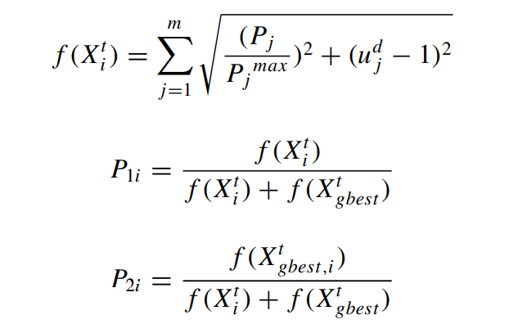

Hybrid Genetic Algorithm and Cat Swarm Optimization (HGACSO)
The fitness value less than the global fitness value at iteration t is considered

Slide 49

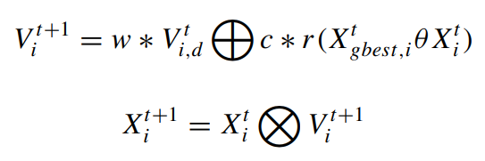
Hybrid Genetic Algorithm and Cat Swarm Optimization (HGACSO)
Multiplication Operator
It is used to update the current cat position. The ith cat position is updated by applying velocity.
The new position is decided based on the velocity vector value.
If the vector value is 1, no update required else it will be adjusted and updated. is the multiplication operator.
In Tracing mode, the CSO is used to compute the velocity and the position which is updated with the following equations

Slide 50
Hybrid Genetic Algorithm and Cat Swarm Optimization (HGACSO)
Cross Over Operation
Once the CSO operations of Seeking and tracing Mode is applied on the chromosomes to find the fitness, apply GA operations.
Before applying Crossover operation, a copy of cats are stored temporarily.

Slide 51
Hybrid Genetic Algorithm and Cat Swarm Optimization (HGACSO)
Mutation Operation
Once the Crossover process is performed, move to Mutation process.
In this process, two PMs are selected randomly and the VM on the selected PM then swap.
Removing Infeasible VMs
After applying the operations of GA and CSO on the chromosomes, there is a possibility of occurring infeasible condition due to VMs migration from one PMs to another.
In order to decrease the infeasibility, reallocate the VMs in the cats and chromosomes after each operation using FFD technique.

Slide 52
Hybrid Genetic Algorithm and Cat Swarm Optimization (HGACSO)
Termination Condition
The HGACSO is terminated, when the current number of iterations are more than the specified value or when there is no improvement in the iteration.
VM migration in HGACSO
There are two conditions of energy consumption of the PM, namely, under utilized and over utilized state.
The under utilization of the PM is considered as the wastage of energy for PM as it is in idle state but still consume 70% of the energy.
In the over utilized stage, the PM utilization is more when compared to specific maximum utilization.
VM migration occurs from the under utilized PM

Slide 53
Hybrid Genetic Algorithm and Particle Swarm Optimisation (HGAPSO)
The main objective is to use GA and PSO together is, they work on random population in finding a solution within a search space.
The crossover of GA will help to migrate the VMs from one to another chromosome.
It is known from the GA algorithm, if larger the solution space then the convergence time will be more and the performance will be poor.
The other reason why GA is poor is, the migration of VMs to from one PM to another will occur randomly.
The probability of searching the optimal solution will be high because of the random migration of VM

Slide 54
Hybrid Genetic Algorithm and Particle Swarm Optimisation (HGAPSO)
In PSO, the particles move from one place to another within the search space by selecting the best global and local positions.
This results in migration of VM from non-efficient PM to efficient PM.
In HGAPSO, first generate a finite number of chromosomes in the initial iterations along with fitness value.
Once the chromosomes fitness value is obtained, sort them in decreasing order

Slide 55
Hybrid Genetic Algorithm and Particle Swarm Optimisation (HGAPSO)
Now discard half of the chromosomes from the population that have less fittest values and consider the other half for further process.
The selected half particles are treated with PSO and then the GA will be applied to get the high quality of chromosomes.
Select the fittest particles for the next iteration at the end of the operations.
Once it finishes all the iterations, it will terminate the process by allocating VMs to PMs.
The HGAPSO consists of three phases for finding the best solution.
The first phase is known as VM allocation, second phase is known as Task scheduling and the last phase is known as VM migration.

Slide 56
Hybrid Genetic Algorithm and Particle Swarm Optimisation (HGAPSO)
VMs Allocation: This consists of generation of the chromosomes and enhancement of chromosomes using PSO and apply Crossover and Mutation operations on the generated chromosomes.
Chromosomes Encoding: If there are s chromosomes generated in the initial population, randomly generate s–1 chromosomes and the remaining one is generated using FFD algorithm.
Fitness Value

Slide 57
Hybrid Genetic Algorithm and Particle Swarm Optimisation (HGAPSO)
Selection Operation:
This operation is performed to find the best chromosomes is based on the fitness value of them.
If ‘s’ is the generation of the chromosomes, select ‘s/2’ for the operation and discard the other half of the chromosomes.
The particle whose probability is high has the higher chances to undergo for further process.
The selected chromosomes will undergo further operations of PSO and GA.

Slide 58

Hybrid Genetic Algorithm and Particle Swarm Optimisation (HGAPSO)
Particle Encoding and Position:
After the selection of the best chromosomes from the above process, mapping of these selected chromosomes are performed.
The ith particle position is described by ‘m’ bit vector at an iteration ‘t’ is presented as the vector value will be 0 or 1.
The particle position is defined by the m-bit binary vector.
In a chromosome, if the PMs contain VMs then the binary vector will be 1 otherwise 0.

Slide 59

Hybrid Genetic Algorithm and Particle Swarm Optimisation (HGAPSO)
Particle Velocity
Velocity is applied on the particle to change the position of the particle, means there is a change in the position of VM from the PM of one to another.
The velocity is measured by 0 or 1. To change the position of first particle, apply random velocity on first iteration.
The velocity of ith particle with t th iteration is given by

Slide 60
Hybrid Genetic Algorithm and Particle Swarm Optimisation (HGAPSO)
Subtraction Operator
Addition Operation
Multiplication Vector
Crossover Mutation
After applying the operations of PSO to find the quality fitness value, they are moved to apply GA operations.
Before applying the GA operations, a copy of the particles is stored temporarily.
A single point crossover operation is applied on the PSO generated particles.
The multipoint crossover will degrade the fitness by migrating more VMs from one chromosome to another by generating infeasible VMs in the chromosomes.

Slide 61
Hybrid Genetic Algorithm and Particle Swarm Optimisation (HGAPSO)
Removing Infeasible VMs:
In order to remove infeasible VMs from the network, FFD technique is used after each iteration.
Termination Condition:
HGAPSO is terminated when the current number of iterations are greater than the maximum set value of iterations or when their is no improvement in the iteration.

Slide 62
Hybrid Genetic Algorithm, Particle Swarm Optimisation and Simulated annealing (HGAPSOSA)
Hybrid Genetic Algorithm, Particle Swarm Optimisation and Simulated Annealing (HGAPSOSA). generates the chromosomes randomly using FFD algorithm as in HGAPSO
Fitness value is found for each chromosomes using the Euclidean function.
Arrange the chromosomes from higher to lower order.
Divide them into two groups, select the half whose fitness value is high and discard the other half.
Apply the PSO algorithm by mapping the chromosomes to the particles.
Calculate the position and velocity of the particles.

Slide 63

Hybrid Genetic Algorithm, Particle Swarm Optimisation and Simulated annealing (HGAPSOSA)
Apply Crossover and Mutation process on the particles.
In Mutation process, Simulated Annealing is applied on GA.
In simulated annealing, PMs are arranged in decreasing order on the basis of the fitness value in chromosomes.
Select the least fittest PM, allocate all VMs of this PM to the energy efficient PM and calculate fitness value of chromosomes.
The VM position is changed permanently if the
else select second least fittest PM in the set of chromosomes

Slide 64
Hybrid Genetic Algorithm, Particle Swarm Optimisation and Simulated annealing (HGAPSOSA)
Perform the same procedure to find least fitness value chromosomes and compare with new and old values.
After applying the PSO, crossover and SA reallocate infeasible VMs in the particles using the reallocation of VMs procedure discussed in HGACSO.
The results demonstrated that the resource utilization was 33%, 21% and 6% more when compared with GA, PSO, SA and the temperature was reduced to 10◦, 6◦ and 3◦ when it is compared with GA, PSO and SA

